Slide 1

Speech keywords extraction
Cs 688 Web mining and graph analytics
Serikzhan Sadakbayev

Slide 2
President of Kazakshtan annual speech
Dear Compatriots! Dear deputies, members of the Government! In accordance with Article 59 of the Constitution of the Republic of Kazakhstan, I declare the third session of the Parliament of the 7th convocation open. Dear deputies! I congratulate everyone on the start of another session of the Parliament! This year our country has entered a new stage of development. In a nationwide referendum, the majority of citizens supported the course of political modernisation. The constitutional reform was a fundamental step in the creation of the New Fair Kazakhstan.
Total number of words: 8106

Slide 4
KeyBERT supports many embedding models that can be used to embed the documents and words:
Sentence-Transformers
Flair
Spacy
Gensim
USE

Slide 5
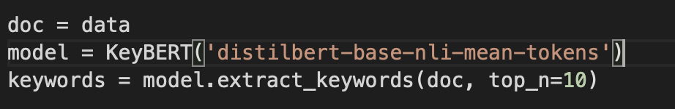
Top 10 words used in the speech (distilbert)
('2025', 0.1766)
('annually', 0.1726)
('2024', 0.1724)
('rallies', 0.1722)
('2023', 0.1695)
('presidential', 0.1615)
('entrepreneurs', 0.1591)
('rally', 0.15)
('reboot', 0.1462)
('president', 0.1454)]

Slide 6
Top 10 phrases with 2 words (distilbert)
('nationwide referendum', 0.3946)
('new presidential', 0.359)
('presidential election', 0.3581)
('2023 parents', 0.3477)
('snap presidential', 0.333)
('next presidential', 0.3097)
('successful entrepreneurs', 0.2868)
('reboot fiscal', 0.2809)
('deputies congratulate', 0.2718)
('presidential terms', 0.2653)

Slide 7
Top 5 phrases with 3 words (distilbert)
('presidential election shortening', 0.4187)
('parliamentary election 2025', 0.44)
('new fair kazakhstan', 0.4453)
('nationwide referendum majority', 0.4677)
('construction fair kazakhstan', 0.4812)

Slide 8
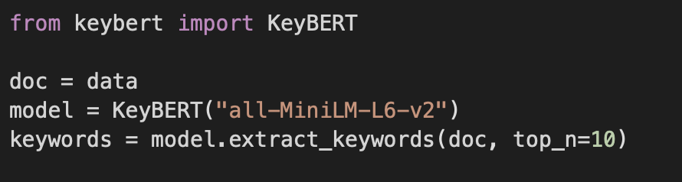
Top 10 words used in the speech (all-MiniLM)
('reforms', 0.4567)
('kazakhstan', 0.4107)
('republic', 0.4029)
('kazakh', 0.3934)
('reform', 0.3927)
('constitutional', 0.371)
('kazakhs', 0.369)
('constitution', 0.3619)
('referendum', 0.3524)
('restructuring', 0.3517)

Slide 9
Top 10 phrases with 2 words (all-MiniLM)
('kazakhstan resettlement', 0.5479)
('kazakhstan declare', 0.5402)
('economic reforms', 0.5051)
('situation kazakhstan', 0.5028)
('kazakhstan model', 0.4961)
('kazakhstan new', 0.4793)
('new kazakhstan', 0.4793)
('government reforms', 0.4722)
('reforms to', 0.466)
('kazakhstan needs', 0.4643)

Slide 10
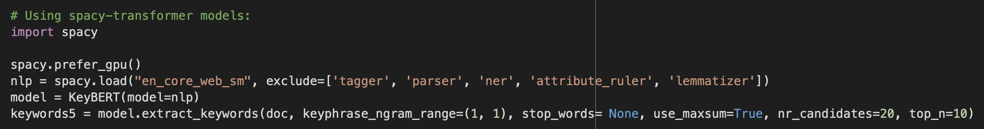
Top 9 words in speech (Spacy model)
('amanat', 0.3235)
('circulation', 0.3291)
('money', 0.3297)
('punishment', 0.3339)
('institution', 0.3436)
('infant', 0.3443)
('school', 0.3476)
('modernisation', 0.3484)
('system', 0.3527)

Slide 11
Top 5 phrases (2 words) in speech (Spacy model)
('bureaucratic system', 0.4733)
('rural cooperation', 0.4736)
('artificial division', 0.4766)
('basic factor', 0.4821)
('major oil', 0.4828)

Slide 12

Thank you for attention!

